Slide 1
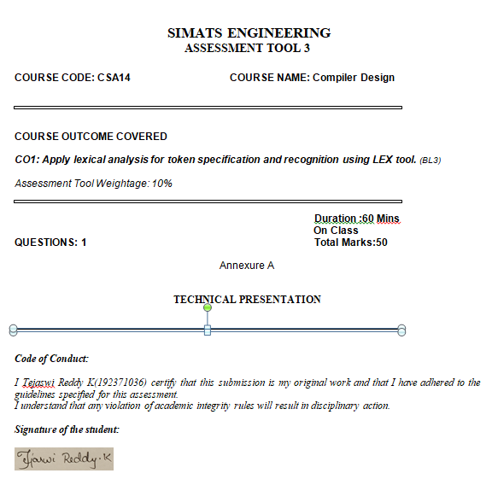

Slide 2
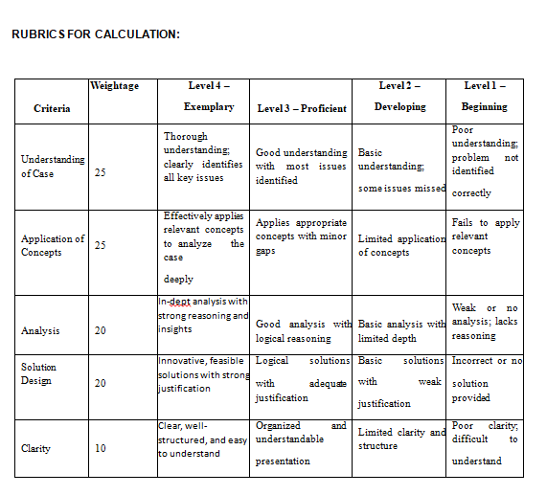

Slide 3

COMPILER DESIGN
Language Processors
Compiler vs Interpreter
How source code becomes a running program — two contrasting strategies for language translation

Slide 4



What is a Language Processor?
A language processor is a software tool that converts a program written in a source language (e.g. C, Java, Python) into a form the machine — or another program — can execute. Without a language processor, a computer, which only understands binary machine code, could never run human-readable code.
THE BIG PICTURE
Source Code
Human-readable (.c, .java, .py)
Three broad categories:
▼
Compiler
Language Processor
Translates the entire source program into machine/target code before execution begins.
Compiler / Interpreter / Assembler
▼
Interpreter
Translates and executes the source program line-by-line, without producing a separate file.
Target Form
Machine code or direct execution
Assembler
Translates assembly language (mnemonics) directly into machine code.
Language Processors — Compiler Design
2

Slide 5
What is a Compiler?
A compiler is a program that reads an entire source program written in a high-level language and translates it, all at once, into an equivalent program in a target language — usually machine code or assembly. The output is a separate executable file that can be run independently, any number of times, without the compiler present.
Source Program
→
Compiler
→
Target Program (Object Code)
Runs LATER, directly on hardware — no compiler needed at run time
Key characteristics:
Checks the whole program for errors before generating any output
Execution is fast, since translation happens only once, in advance
Produces an independent executable (e.g. .exe)
Examples: GCC (C/C++), javac (Java to bytecode)
Language Processors — Compiler Design
3

Slide 6
What is an Interpreter?
An interpreter is a program that translates and executes source code one line (or statement) at a time, without producing a separate target file. It reads a line, translates it, executes it immediately, then moves to the next line — repeating until the program ends or an error occurs.
Read Statement
→
Translate
→
Execute Immediately
↺ repeats for every statement, until the program finishes
Key characteristics:
No separate object file — the interpreter must be present every time the program runs
Stops immediately when it hits an error, without checking the rest of the code first
Slower overall execution, since translation is repeated every run (and every loop pass)
Examples: Python (CPython), the classic BASIC interpreter
Language Processors — Compiler Design
4

Slide 7
Compiler vs Interpreter
Basis | Compiler | Interpreter
Translation unit | Entire program, at once | One statement at a time
Output | Separate target/object file | No separate file produced
Execution speed | Fast (translated only once) | Slower (re-translated each run)
Error detection | All errors reported after full compilation | Stops at the first error encountered
Memory use | Needs memory for full target code | Needs less memory; no target code stored
Debugging | Harder — errors mapped back to source | Easier — pinpoints the failing line directly
Examples | C, C++ (GCC) | Python, JavaScript (traditional engines)
Language Processors — Compiler Design
5

Slide 8
Phases of Compilation
A compiler doesn't translate in one leap — it works through six well-defined phases
1
Lexical Analysis
2
Syntax Analysis
3
Semantic Analysis
Groups characters into tokens (keywords, identifiers, operators)
Checks token order against grammar; builds a parse tree
Checks meaning — type checking, scope, consistency
4
Intermediate Code Gen
5
Code Optimization
6
Code Generation
Produces a machine-independent intermediate form
Improves the intermediate code for speed/space
Produces the final target machine code
Language Processors — Compiler Design
6

Slide 9


Compiler: Strengths & Trade-offs
Advantages
Disadvantages
Very fast execution — translation happens only once, upfront
Whole program is checked, so many errors surface before it ever runs
Produces a standalone executable — the compiler isn't needed to run it
Better opportunity for code optimization across the entire program
Source code can be kept private (only the compiled binary is shared)
Compilation itself takes time, especially for large programs
Must recompile the entire program after every code change
Error messages can be harder to trace back to the exact source line
Generated executable is often platform/hardware specific
Not ideal for quick experimentation or interactive testing
Language Processors — Compiler Design
7

Slide 10
Interpreter: Strengths & Trade-offs
Advantages
Disadvantages
Immediate execution — great for testing, learning, and quick scripts
Errors are reported precisely, at the exact line where they occur
No separate compilation step — edit and run right away
Highly portable: the same source runs anywhere the interpreter exists
Easier interactive debugging (e.g. Python's REPL / shell)
Slower execution — each line is re-translated every time it runs
The interpreter must always be present on the running machine
Loops re-translate the same statements repeatedly, wasting effort
Only sees errors as it reaches each line — not the whole program upfront
Source code is exposed, since no separate compiled binary is created
Language Processors — Compiler Design
8

Slide 11

The Hybrid Approach: Best of Both
Modern languages rarely use a pure compiler or pure interpreter. Instead, most combine both ideas: a compiler first translates source code into an intermediate form, which is then interpreted — or further compiled Just-In-Time (JIT) — while the program runs.
Source Code
→
Compiler
→
Bytecode / Intermediate
→
Interpreter + JIT
→
Execution
Real-world examples:
Java
javac compiles to bytecode; the JVM interprets it and JIT-compiles hot code paths to native machine code.
Python (CPython)
Source is compiled to bytecode (.pyc) first, then that bytecode is interpreted by the Python VM.
JavaScript (V8)
Parses to bytecode immediately, then uses JIT compilation to speed up frequently-run functions.
Language Processors — Compiler Design
9

Slide 12


Key Takeaways
Compiler
Interpreter
Translates the whole program in advance → fast, standalone execution, but a slower edit-run cycle.
Translates and runs line-by-line → immediate feedback and easy debugging, but slower overall runtime.
Hybrid systems
Choosing between them
Java, Python, and JavaScript combine both, using bytecode and JIT compilation for a practical middle ground.
The right choice depends on the trade-off you need: raw speed vs. development flexibility.
Language Processors — Compiler Design
10

Slide 13

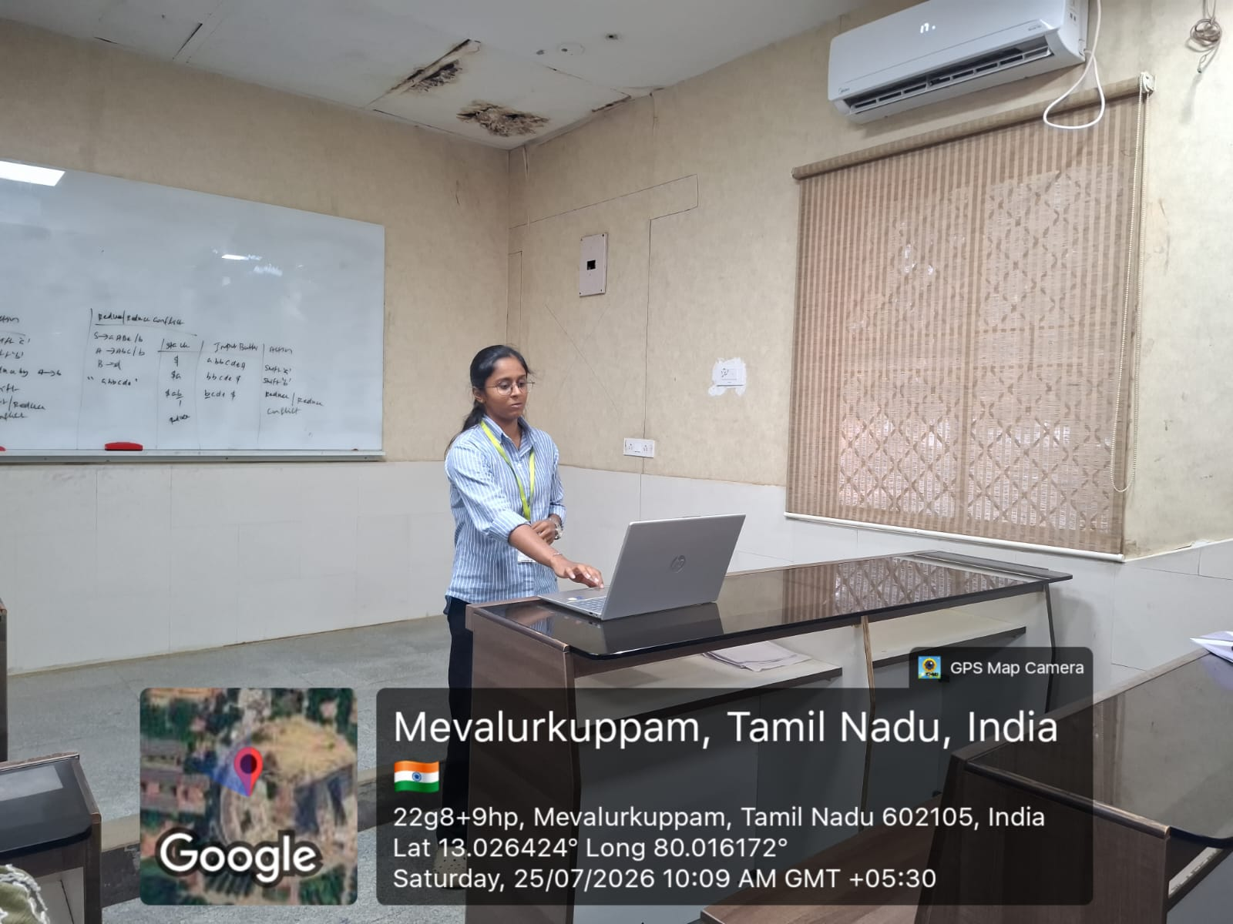
GEOTAG PHOTOS -

